Slide 1

AGILE MANIFESTO AND PRINCIPLES
“BUILDING A PRODUCT SUCESSFULLY DOESN’T MEANS BUILDING A SUCCESSFUL PRODUCT”

Slide 2
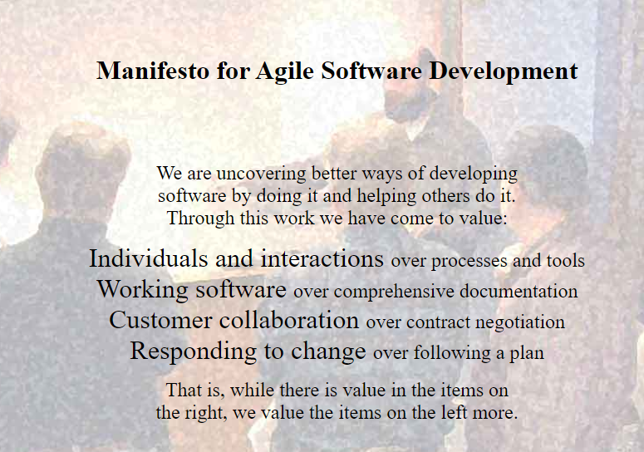

Slide 3
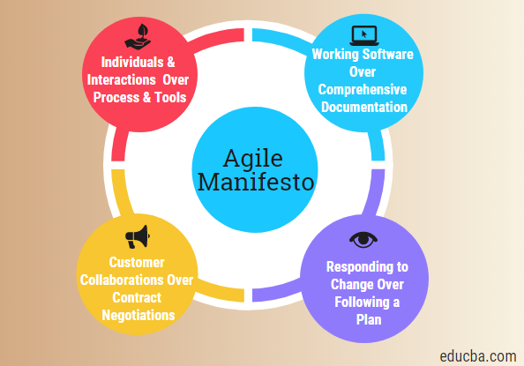

Slide 4
12
principles
for Agile development

Slide 5
1. Individuals and Interactions Over Processes and Tools It is the people who respond to business needs and drive the development process. If the process or the tools drive development The team is less responsive to change and less likely to meet customer needs. Communication is an example of the difference between valuing individuals versus process. 2. Working Software Over Comprehensive Documentation Agile does not eliminate documentation, but it streamlines it in a form that gives the developer what is needed to do the work without getting bogged down in minutiae. Agile documents requirements as user stories, which are sufficient for a software developer to begin the task of building a new function.

Slide 6
3. Customer Collaboration Over Contract Negotiation The Agile Manifesto describes a customer who is engaged and collaborates throughout the development process, making. This makes it far easier for development to meet their needs of the customer. Agile methods may include the customer at intervals for periodic demos, but a project could just as easily have an end-user as a daily part of the team and attending all meetings, ensuring the product meets the business needs of the customer. 4. Responding to Change Over Following a Plan With Agile, the shortness of an iteration means priorities can be shifted from iteration to iteration and new features can be added into the next iteration. Agile’s view is that changes always improve a project; changes provide additional value.

Slide 7
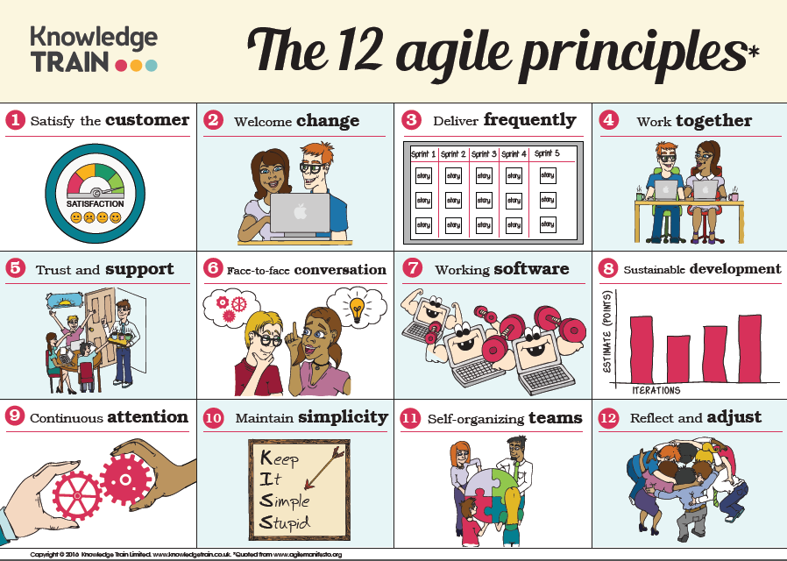

Slide 8


1. Satisfaction & delivery
Our highest priority is to
satisfy the customer
through early and
continuous delivery
of valuable software

Slide 9

2. Welcome changing
Welcome changing requirements
even late in development. Agile processes harness change for the
customer's competitive advantage.

Slide 10

3. Deliver frequently
Deliver
working software
frequently, from a couple of weeks to a couple of months, with a preference to the
shorter timescale

Slide 11


4. Communication is the key
Business people and developers
must work together
daily throughout the project.

Slide 12
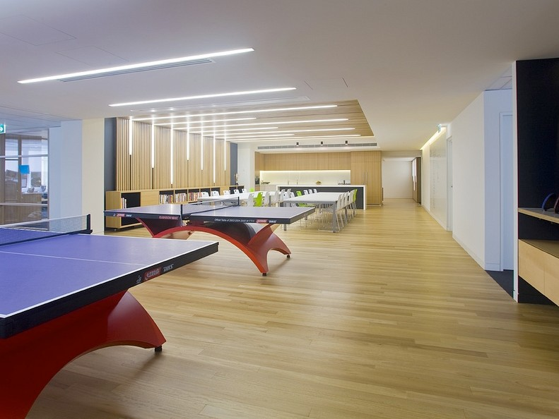
5. Environement & trust
Build projects
around motivated individuals. Give them the
environment and support
they need, and trust them to get the job done.

Slide 13
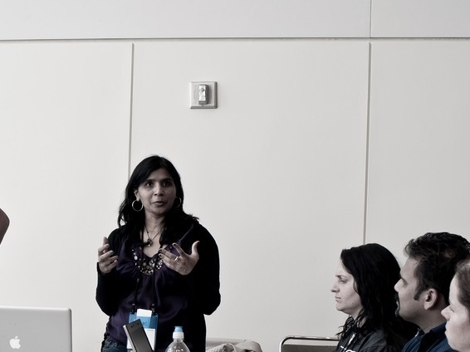

6. Face-to-face communication
The most efficient and effective method of conveying information to and within
a development team is
face-to-face
conversation

Slide 14


7. Measuring progress by soft
Working software is
the primary measure
of progress

Slide 15

8. Sustainable development
Agile processes
promote sustainable development.
The sponsors, developers, and users should be able to
maintain a constant
pace indefinitely.

Slide 16

9. Attention to details
Continuous attention to
technical excellence and good design
enhances agility.

Slide 17

10. The power of less
Simplicity is essential
the art of maximizing the amount of work not done

Slide 18

11. Self-organizing teams
The best architectures, requirements, and designs
emerge from self-organizing teams.

Slide 19


12. Ajusting at regular intervals
At regular intervals, the team reflects on how to become more effective, then
tunes and adjusts its behavior accordingly

Slide 20
Uniqueness
Always looking for
the most elegant solution

Slide 21
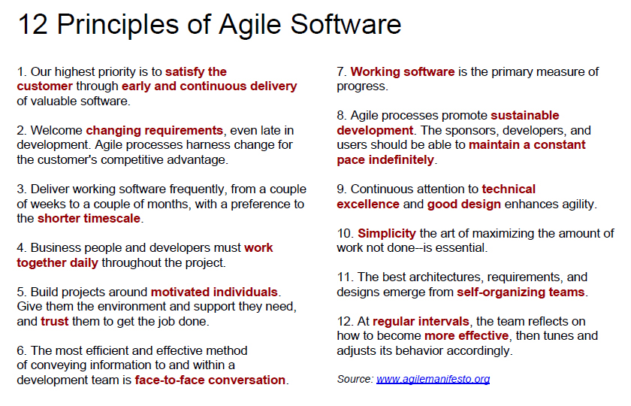

Slide 22
QUIZZ?

